Slide 1
CSE496: Completed project presentation on DDoS detection using machine learning
Instructor:
Annajiat Alim Rasel (AAR)
MD. Faisal Ahmed (FLA)
Group Members:
Mahdi Hossain - 20301194
Kazi Shahed Mamun - 20301471
Taimoor Fahim - 23241093

Slide 2
About the Dataset
The dataset has a 78 features that are required to identify DDoS attacks.
Destination port, backward and forward packets, flow duration, idle and active time are some of the important requirements to identify any DDoS attacks.
The dataset has some null values that we find out using isnull() function of pandas library.

Slide 3
Data Pre-Processing and Splitting
Before training our model we have used several pre-processing methods in order to improve the generalizability of the dataset.
We processed the dataset by removing null values.
Then we converted the labels in the DataFrame to numerical values for usage.
After preprocessing the dataset, we split into 70% for training and 30% for testing

Slide 4
The predictions that we derived after using the algorithms
Accuracy score: The accuracy of the trained model in detecting DDoS attacks.
Precision score: Precision is a measure of how many of the positive predictions made are correct (true positives).
Recall score: Recall score is a measure of how many of the positive cases the classifier correctly predicted, over all the positive cases in the data.
F1 score: It is a measure combining both precision and recall.

Slide 5
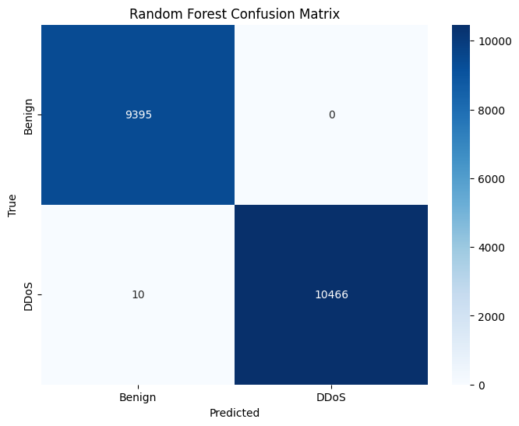
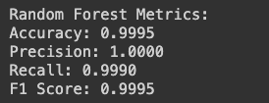
Training the model using Decision Tree Algorithm
After training the model using the score as follows
The confusion matrix of the trained data:

Slide 6
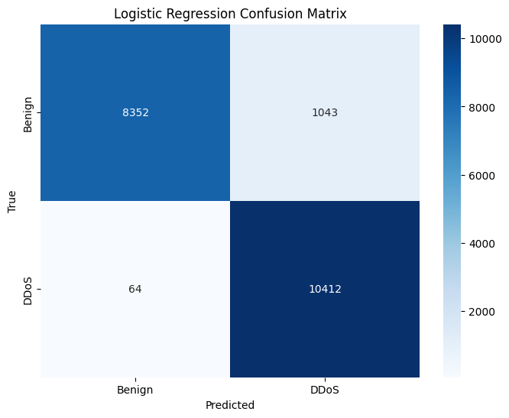
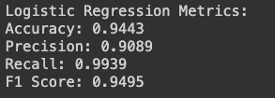
Training the model using Logistic Regression Algorithm
After training the model using the score as follows:
The confusion matrix of the trained data:

Slide 7

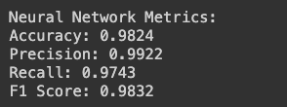
Training the model using Neural Network Algorithm
After training the model using
The confusion matrix of the trained data:

Slide 8
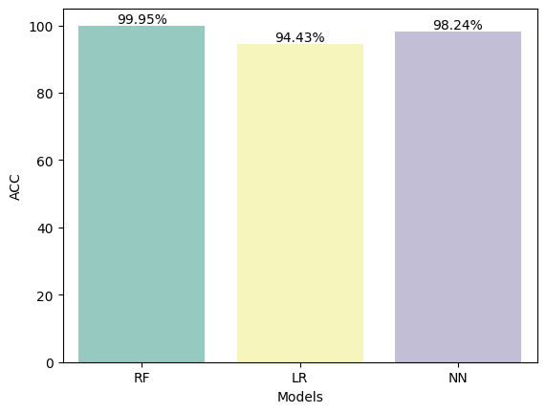
Accuracy score comparison using Barchart

Slide 9
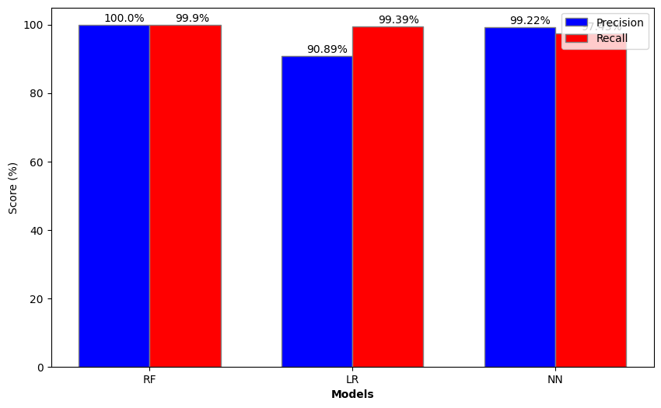
Precision, Recall and F1 score comparison using Barchart

Slide 10
THANK YOU

